Slide 1
Top of the Rainbow...RED!
---Indent
At the beginning of each paragraph there should be an indention (tab key). Some people have been taught to use their index finger as a guide to measure the space. Most students should have 4-5 paragraphs (at least two body paragraphs).

Slide 2
Next up...ORANGE!
--- Capitalization
Check:
Proper Nouns (names, organizations, places, authors, titles)
Beginnings of Sentences
Title
Authors in parentheses (sources)

Slide 3
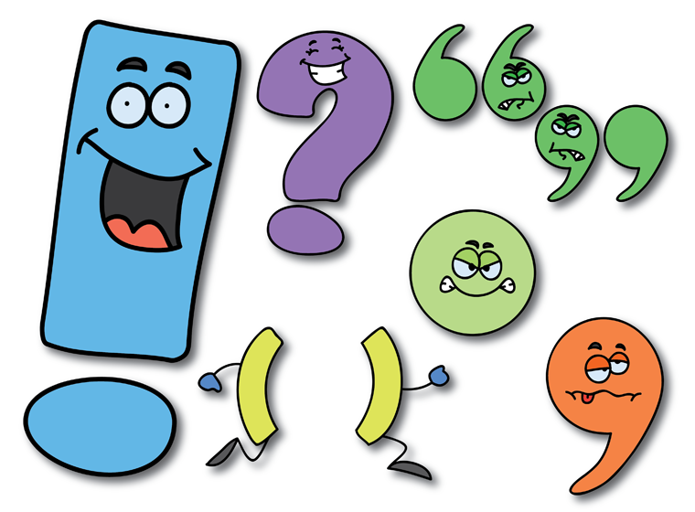
Next to come...YELLOW!
---Punctuation
Your paper should include:
Periods
Questions marks
Commas
Apostrophes
Quotations
Parentheses
No contractions (spell out)

Slide 4
Middle of the Rainbow...GREEN!
---Transition Words
Transitions should be naturally placed/not sound choppy. Places where transitions must be located:
In front of evidence (In the article _______, it states, “______”.)
In front of synthesis (This proves that, For example, For instance).
At the beginning of the paragraph addressing the counterclaim (On the other hand, However, Some people argue)
At the beginning of Conclusion paragraph (In conclusion, Clearly, At last)

Slide 5
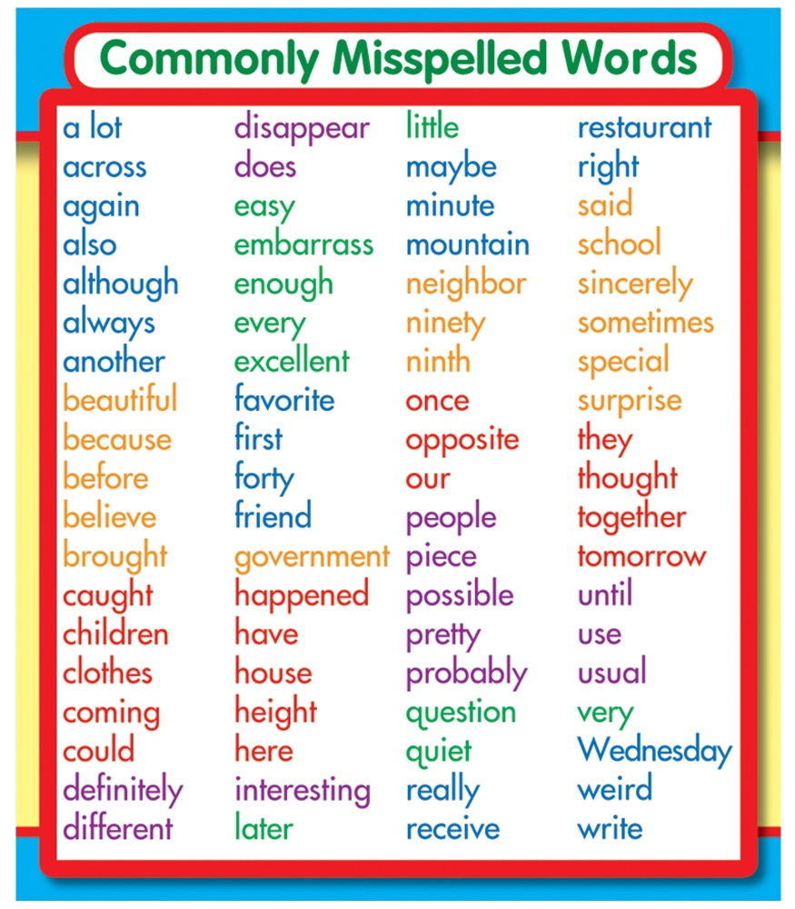
---Misspelled Words...Blue
Don’t forget about:
Their, There
To, Two, Too
***no “you’s” anywhere….***

Slide 6
Bottom of the Rainbow...PURPLE!
---Interesting Words
These are words that are JUICY! They enhance the paper a ton! Make sure every sentence doesn’t begin with “he”. Read the sentences aloud and tell someone to add details if necessary. Make sure the hook grabs the reader’s attention in the intro.

Slide 7
In Text Citations...PINK!
---Giving credit to authors
Credit should be given to an author after each piece of evidence
The author’s last name/company should be in parentheses followed by a period.
Example: In the article, “History” it states that “Christopher Columbus sailed the ocean blue in 1492” (Bio).

Slide 8
Structure...Brown
---Hook: should grab the reader’s attention
---Bridge: should connect the hook and thesis
---Conclusion: check to see if the thesis and hook are similar to the originals in the intro/body, but still different/reworded

